Slide 1

Applications of
First Order Ordinary
Differential Equations
Notes:
h24

Slide 2
I. Orthogonal Trajectories of
A Family of Curves F(x,y,C) = 0
1. Form the DE F(x,y,y’)=0.
2. In the DE found in (1), replace dy/dx by –dx/dy.
3. The solution of the DE G(x,y,x’)=0 is the equation
of the orthogonal trajecctories of F(x,y,C)=0.

Slide 3
Examples
1. Find the orthogonal trajectories of the family
of curves x² + y² = cx.

Slide 4
Examples
2. Find the orthogonal trajectories of the family
of curves y² = 4cx.

Slide 5
Examples
3. Find the orthogonal trajectories of the family
of circles which pass through the origin
and which have their centers on the x-axis.

Slide 6
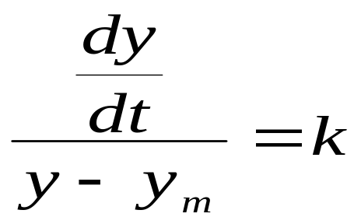
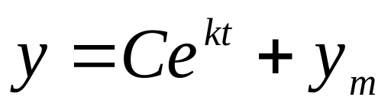
II. Newton’s Law of Cooling
Newton’s Law
The time rate of change of the temperature of a
body is proportional to the temperature difference
between the body and its surrounding medium.
Let y denote the temperature of the “body”
y_{m} denote the temperature of the medium
t denote the time

Slide 7
Examples
A body at a temperature of 50ºF is placed in an oven
whose temperature is kept at 150ºF. If after 10 minutes,
the temperature of the body is 75ºF, find the temperature
of the body at any time t. When will the body reach a
temperature of 100ºF?

Slide 8
Examples
2. A body of unknown temperature is placed in a room
which is held at a constant temperature of 30ºF. If
after 10 minutes, the temperature of the is 15ºF, find
the initial temperature of the body.

Slide 9
Examples
3. A body is placed in air kept kept at 10ºC and
cools from 200ºC to 100ºC in 30 minutes.
Find how long it would take the body to cool
from 200ºC to 100ºC in air kept at 5ºC.

Slide 10

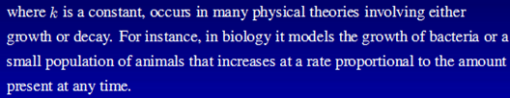
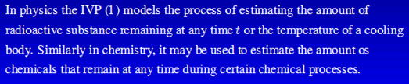
III. Law Growth and Decay

Slide 11
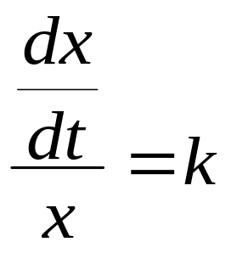
III. Law Growth and Decay
Assumption:
The rate of change of a substance is
proportional to the amount of substance
present any instant.
Let x denote the amount of substance
at any given instant
t denote the time
x = Ce^{kt}

Slide 12
Examples
A certain population of bacteria is known to grow at a
rate proportional to the amount present in a culture that
provides plentiful food and space. Initially, there are
250 bacteria, and after 7 hours, 800 bacteria are
observed. a) Find the number of bacteria at any instant.
b) Approximate the number of bacteria after 24 hours.
c) When will the population reach 2500?

Slide 13
Examples
2. A fossilized bone is found to contain 1/1000
of the original amount of radioactive carbon
C-14. Given the half-life of C-14 in
approximately 5600 years, determine the age
of the fossil.

Slide 14

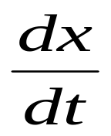
IV. Fluid Mixtures
incoming
mixture
R_{i} = C_{i}Q_{i}
outgoing
mixture
R_{o} = C_{o}Q_{o}
Let x – amount of substance in the mixture
- time rate of change of x
C – concentration
Q – volume flow rate
R_{i},R_{o} – rate of entry and exit of x

Slide 15
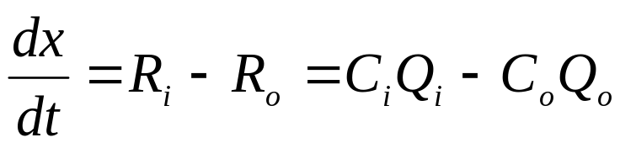

IV. Fluid Mixtures
incoming
mixture
R_{i} = C_{i}Q_{i}
outgoing
mixture
R_{o} = C_{o}Q_{o}
Model:
Concentration of x = (amount of x)/volume
Volume at any time:

Slide 16
Examples
1. Initially 50 pounds of salt is dissolved in a large tank holding 300 gallons of water. A brine solution is pumped into the tank at a rate of 3 gallons per minute and a well-stirred solution is then pumped out at the same rate. If the concentration of the solution entering is 2 pounds per gallon, determine the amount of salt in the tank at any time. How much salt is present after 50 minutes? After a long time?

Slide 17
Examples
2. Initially 50 pounds of salt is dissolved in a large tank holding 300 gallons of water. A brine solution is pumped into the tank at a rate of 3 gallons per minute and a well-stirred solution is then pumped out at the 2 gal/min. If the concentration of the solution entering is 2 pounds per gallon, determine the amount of salt in the tank at any time. How much salt is present after 50 minutes? After a long time?

Slide 18
Examples
2. A tank contains 80 gallons of pure water. A brine solution with 2 lb/gal of salt enters at 2 gal/min, and the well-stirred mixture leaves at the same rate. Find a) The amount of salt in the tank at any time
b) The time at which the brine leaving will contain 1 lb/gal of salt.

Slide 19
V. Newton’s Second Law of Motion
Theory:
The sum of the forces acting on a body is
proportional and in the same direction as the
acceleration.
ΣF = ma
R
F
W

Slide 20
Example
2. A long very smooth board is inclined at an angle of
10º with the horizontal. A weight starts from rest 10 ft
from the bottom of the board and slides downward
under the action of gravity alone. Find how long it will
take the body to reach the bottom of the board and
determine the terminal speed.

Slide 21
Example

Slide 22
Basic Concepts

Slide 23
Basic Concepts

Slide 24
Basic Concepts

Slide 25
Basic Concepts

Slide 26
Basic Concepts

Slide 27
Basic Concepts

Slide 28
Basic Concepts

Slide 29
Basic Concepts

Slide 30
Basic Concepts

Slide 31
Basic Concepts

